Slide 1
CHAPTER 3
Lists, Stacks, and Queues
【Definition】Linear Data Structure is a finite sequence of data elements in the form of:
( A1, A2, ⋅⋅⋅ , An )
☞ The position of Ai in the linear structure is i
All elements in the structure must have same type
n is length of the structure
Notes:
In Chapter 1, we have talked some concepts and terminolgy about data structure
Now we will begin to discuss some real data structures, they are lists,stack, and queues which are very common and basic, we can see them quite often in many applications. These data structures belong to one kind of generic data structure, which is called linear structure of the form A1,A2,…An,.
Linear data structure is a sequence of finite data elements,
in this kind of structure, all data are one after another, each data element has a positon, position is meaningful.
Data element can be any type, but they must be same type, eg a list of integer, a list of student, string is also list.
N is length of list, if N is 0 the list is empty.

Slide 2
§1 Abstract Data Type (ADT)
【Definition】Data Type = { Objects } ∪ { Operations }
〖Example〗 int = { 0, ±1, ±2, ⋅ ⋅ ⋅, INT_MAX, INT_MIN }
∪ { +, −, ×, ÷, %, ⋅ ⋅ ⋅ }
data type
tells the computer what a data segment represents in the memory
and how these data can be operated
int, float, char, …
+, -, *, /, %, …
Notes:
Before going into detail of each data structure, we will discuss a new concept first, ADT, which is very important concept in our course.
Follow ppt

Slide 3
§1 Abstract Data Type (ADT)
【Definition】Data Type = { Objects } ∪ { Operations }
〖Example〗 int = { 0, ±1, ±2, ⋅ ⋅ ⋅, INT_MAX, INT_MIN }
∪ { +, −, ×, ÷, %, ⋅ ⋅ ⋅ }
【Definition】An Abstract Data Type (ADT) is a data type that is organized in such a way that the specification on the objects and specification of the operations on the objects are separated from the representation of the objects and the implementation on the operations.
Notes:
功能与具体实现方式的分离

Slide 4
§2 The List ADT
❖ ADT:
Objects: ( item₁, item₂, ⋅⋅⋅ , item_{N} )
Operations:
☞ Finding the length, N, of a list.
☞ Printing all the items in a list.
☞ Making an empty list.
☞ Finding the k-th item from a list, 0 < k ≤ N.
☞ Inserting a new item after the k-th item of a list, 0 < k ≤ N.
☞ Deleting an k-th item from a list.
☞ Finding next of the current item from a list.
☞ Finding previous of the current item from a list.
Notes:
Now let’s look into ADT of list, its objects is a sequence of items, it has several operations.
In fact, the list we are talking here is a general list. In practice, we may have different kind of list, they may have diff operation, eg. Student table in DB.
有关线性表的几点说明:
此处讨论的是一种比较抽象的线性表，是许多实际应用线性表公共特征的抽象。在实际应用中，各种线性表的使用差别很大，如：
文件、数据库表
堆栈、队列
有序表
顺序表
这些线性表重要的公共特征是：元素的位置是有意义，数据的操作往往与位置有关。

Slide 5
Example: C＝A∪B
LA
3 | 5 | 1 | 2 | 11 | 9 | 4
LB
2 | 10 | 6 | 1 | 7 | 4
LC
3 | 5 | 1 | 2 | 11 | 9 | 4 | 10 | 6 | 7
Notes:
抛离了具体的实现，只注重逻辑上的功能。
就像盖房子，建筑师负责设计房子的层数，房间的布局，展现的效果，但是不关心使用什么材料，工程实现的先后顺序。
建筑师做的东西都在图纸上，是“抽象的房子”
我们在学习数据结构的时候，也先从图纸上考虑“抽象的数据类型”

Slide 6
Example: C＝A∪B
List Union(List A, List B) {
List C; Position pA, pB, pC; ElementType e;
C = CreateList();
pC = Header(C);
pA = First(A);
while (pA) {
e = Retrieve(pA);
Insert(e, C, pC);
pA = Advance(pA);
}
pB = First(B);
while (pB) {
e = Retrieve(pB);
if (!Find(e, A))
Insert(e, C, pC);
pB = Advance(pB);
}
return C;
}
Why create C,
but not A and B?
Notes:
抛离了具体的实现，只注重逻辑上的功能。
就像盖房子，建筑师负责设计房子的层数，房间的布局，展现的效果，但是不关心使用什么材料，工程实现的先后顺序。
建筑师做的东西都在图纸上，是“抽象的房子”
我们在学习数据结构的时候，也先从图纸上考虑“抽象的数据类型”

Slide 7
1. Simple Array implementation of Lists
§2 The List ADT
array[ i ] = item_{i}
Address
Content
……
……
Sequential mapping
array+i
item_{i}
array+i+1
item_{i+1}
……
……
 MaxSize has to be estimated.
 Find_Kth takes O(1) time.
 Insertion and Deletion involve a lot of data movements which takes time.
Notes:
9.23
ADT is logic description of data structure, it does not mention how data structure implement inside computer. Usually we have two kinds of implemention methods, one is called array implementation, another is linked list. When we use array implementation, there are several advantages and disadvantages.
MaxSize: Usually list is changed dynamicly as program running, for example, we may use a student list to represent students who attend this lecture, this term there may be 100, next term may be 200.
Find_Kth: it need constant time, because we calculate address of kth element in the array, this feature is called random access, it is a very important feature of array.
Insertion and deletion: all the elements from ith item will be moved back.

Slide 8
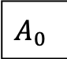
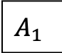
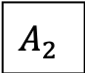
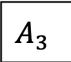
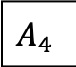
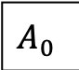
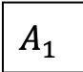
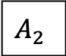
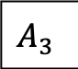
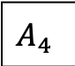
linked lists
a linked list
linked list with actual pointer values
to access a linked list
a pointer variable that stores the address of the first cell
800
712
992
692
0
1000
800
712
992
692
1000

Slide 9
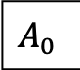
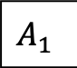
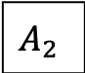
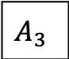
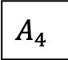
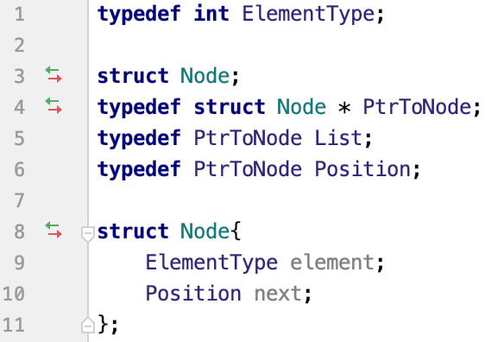
type declarations for linked lists
800
712
992
692
0
1000
800
712
992
692
1000

Slide 10
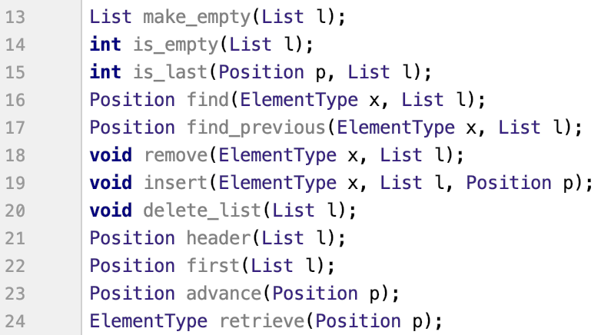
operations

Slide 11
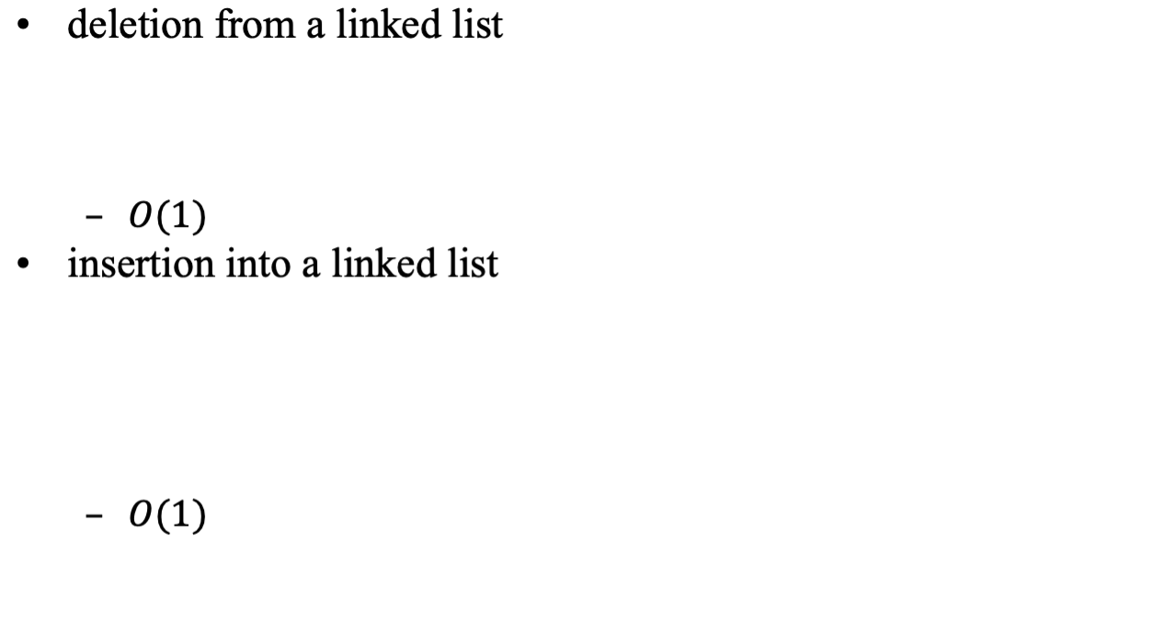
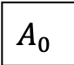
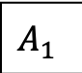
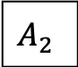
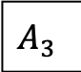
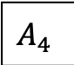
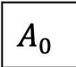
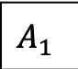
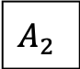
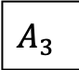
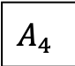
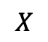
linked lists

Slide 12
2. Linked Lists
§2 The List ADT
ptr
Address
Data
Pointer
ZHAO
QIAN
0010
0011
0110
1011
SUN
QIAN
ZHAO
LI
1011
0010
0011
NULL
SUN
LI
NULL
To link ‘ZHAO’ and ‘QIAN’:
PtrToNode N1, N2 ;
N1 = (PtrToNode)malloc(sizeof(struct Node));
N2 = (PtrToNode)malloc(sizeof(struct Node));
N1->Element = ‘ZHAO’ ;
N2->Element = ‘QIAN’ ;
N1->Next = N2 ;
N2->Next = NULL ;
ptr = N1 ;
What is pointer
in C language?
Head pointer ptr = 0110
Locations of the nodes may
change on different runs.
Declaration:
struct Node;
typedef struct Node *PtrToNode;
typedef PtrToNode List, Position;
typedef struct Node {
ElementType Element ;
PtrToNode Next ;
} ;
List ptr;
ptr
ZHAO
QIAN
NULL
Notes:
9.27
Recall
In array implementation, data elements are stored seqly in memory, which is consistent with seq of list, so we do not need extra method to represent relation of list.
In linked list, data is stored randomly in memory, relation is represent by pointer, before we talk linked list in detail, let first recall what is pointer.
In linked lists, data is stored randomly in memory, for each data element there is a pointer which is address of next elem. So data element in linked list is represented by node which contain two parts: data and pointer. Data is data element of list, pointer is address data are not stored seqly in mem,

Slide 13

 takes O(1) time.
§2 The List ADT
Insertion
node
ptr
...
...
a₁
a_{i}
a_{i+1}
a_{n}
NULL
① temp->Next =
node->Next
② node->Next = temp
b
temp
Question: What will happen
if the order of the two steps is reversed?
Question: How can we insert a new first item?
Notes:
9.22
Now let’s discuss how to insert a node into linked list. Assume we have a linked list which has ptr as head pointer. Now we want to insert a new element ‘b’ after ‘ai’. Assume ‘node’ is pointer to the node containing ai, ‘temp’ is pointer to the node containing b.
Question1:
Answer: the link will be broken, so in linklist operation we must be careful when we change the next ptr in the list, the safeway to do it is to change ptr which is not useful
Question2: in this example we need a ptr pointing to the node which is previous to the new inserted node

Slide 14
 takes O(1) time.
§2 The List ADT
Deletion
pre
ptr
...
...
a₁
a_{i}
a_{i+1}
a_{n}
NULL
① pre->Next =
node->Next
② free ( node )
b
b
Question: How can we
delete the first node from a list?
node
node
Answer: We can add a dummy
head node to a list.
Notes:
Now let’s see how to delete a node from linked list. Assume we want to delete the node after ‘ai’. Assume ‘pre’ is pointer to the node containing ai and ‘node’ is pointer to the deleted node
Note that we must have a pointer to the node before we delete it
Question2: in this example we need a ptr pointing to the node which is previous to the deleted node

Slide 15

linked lists

Slide 16
Insert
struct Node;
typedef struct Node *PtrToNode;
typedef PtrToNode List, Position;
typedef struct Node {
ElementType Element ;
PtrToNode Next ;
} ;
/* Insert (after legal position P) */
/* Header implementation assumed */
/* Parameter L is unused in this implementation */
void
Insert( ElementType X, List L, Position P )
{
PtrToNode TmpCell;
TmpCell = malloc( sizeof( struct Node ) );
TmpCell->Element = X;
TmpCell->Next = P->Next;
P->Next = TmpCell;
}
Same interface for
different implementation
Notes:
Here is the algorithm of insertion, we have 3 parameters, just recall the type def for linked list, in the def PtrToNode List, Position are same types with diff name, from this alg we see why
need create a new node to hold elem to insert.

Slide 17
Delete
struct Node;
typedef struct Node *PtrToNode;
typedef PtrToNode List, Position;
typedef struct Node {
ElementType Element ;
PtrToNode Next ;
} ;
/* Delete (after legal position P) */
/* Assume use of a header node */
void
Delete(List L, Position P )
{
PtrToNode TmpCell;
TmpCell = P->Next;
P->Next = TmpCell->Next; /* Bypass deleted cell */
free( TmpCell );
}
Notes:
10.14

Slide 18
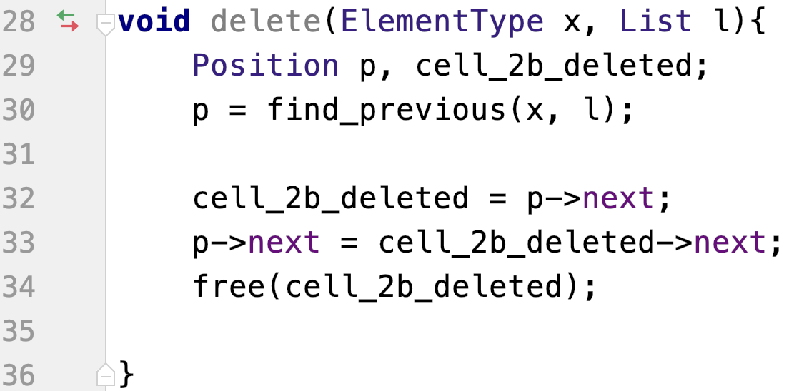
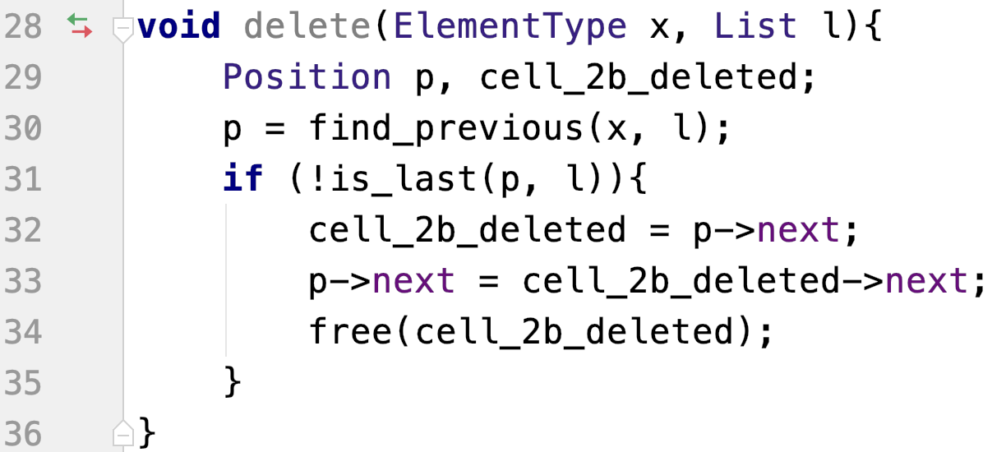
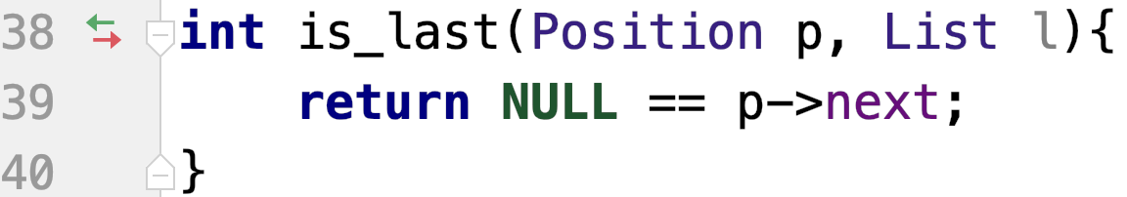
deletion from a linked list
Notes:
如果p是最后一个节点那么p->next == NULL，也就是下一个节点不存在，也就没法有next域了，这时候cell_2b_deleted->next == p->next->next是一个未定义的量，程序出错

Slide 19
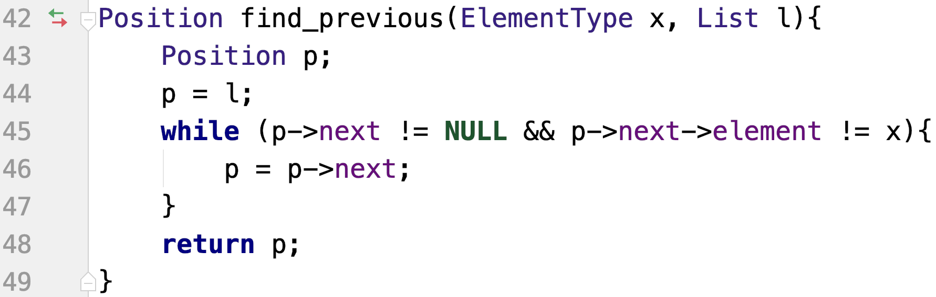
find previous
CAUTION!
the first/last node in the list
the empty list

Slide 20
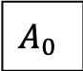
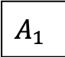
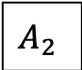
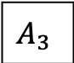
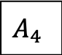
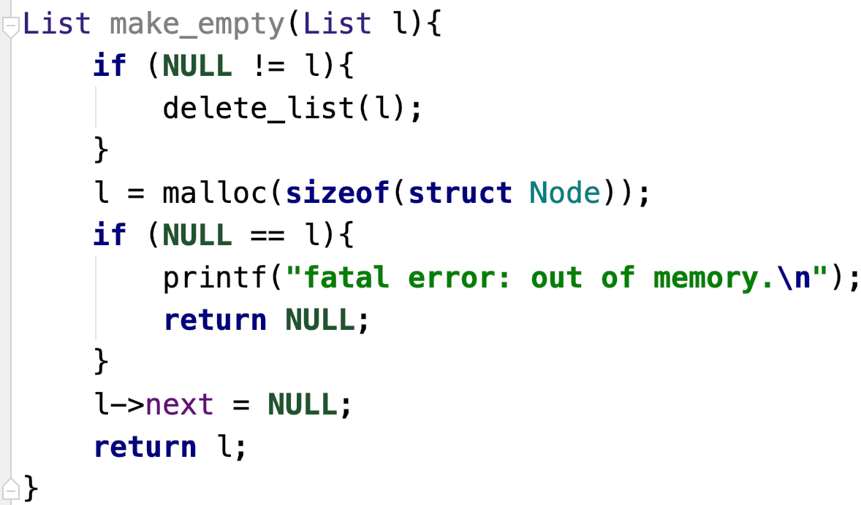
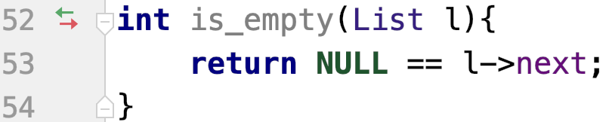
sentinel
header or dummy node
empty list with header
header
header

Slide 21
CreateList
List
CreateList( void )
{
List L;
L = (List)malloc( sizeof( struct Node ) );
L->Next = NULL;
return L;
}

Slide 22
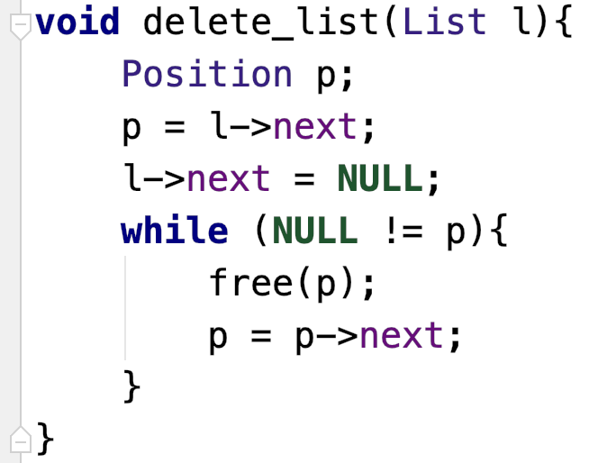
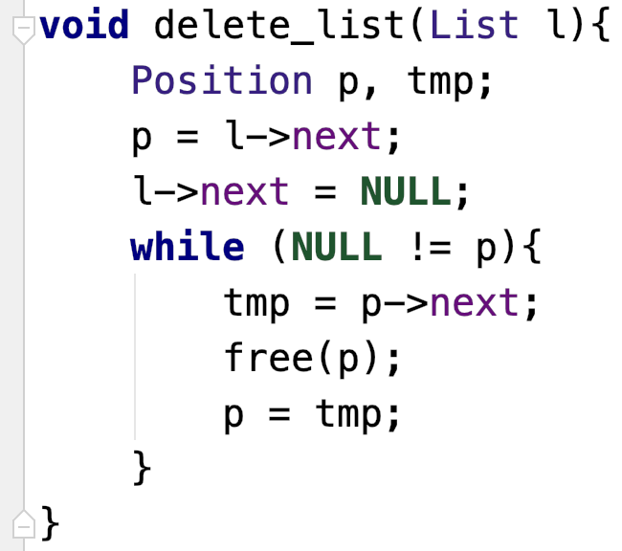
delete a list

Slide 23
DeleteList
void
DeleteList( List L )
{
PtrToNode P, Tmp;
P = L;
while( P != NULL )
{
Tmp = P->Next;
free( P );
P = Tmp;
}
}

Slide 24
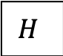
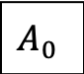
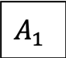
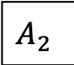
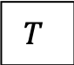
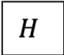
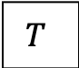
doubly linked lists
a doubly linked list with header and tail nodes
an empty doubly linked list with header and tail nodes

Slide 25
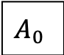




circularly linked lists
a double circularly linked list

Slide 26
FindKth
L
21
18
30
75
42
56
∧
p
p
p
j
1
2
3
Notes:
From two operations we just discussed, we should note that we must first find the previous node to the inserted node or deleted node. We may find the previous in diff way, here I will give two cases

Slide 27
/* Assumes a header */
Position
FindKth( int K, List L )
{
Position P;
P = L->Next; J=1;
while( P && J<K ) {
P = P->Next;
J++;
}
if (J==K) return P;
else return NULL;
}

Slide 28
FindPrevious
/* Assumes a header */
Position
FindPrevious( ElementType X, List L )
{
Position P;
P = L;
while( P->Next != NULL && P->Next->Element != X )
P = P->Next;
if (P->next) return P;
else return NULL;
}

Slide 29

Doubly Linked Circular Lists
§2 The List ADT
typedef struct node *node_ptr ;
typedef struct node {
node_ptr prev;
element item;
node_ptr next;
} ;
prev
next
Uhhh ... Then I’ll have to
go from the 1st node again.
But hey, why do I wantta
find the previous node?
•
item
•
Don’t we have
enough headache already?
Why do we need
the doubly linked lists?
ptr = ptr->prev->next
= ptr->next->prev
I’ll go from the 1st node
to the m-th node.
Suppose you have a list
1->2->3->…->m.
Now how would you
get the m-th node?
Why do you ask me? :-)
Maybe you wantta delete
the m-th node?
A doubly linked circular list with head node:
Then you are asked to find
its previous node m − 1?
H
•
•
•
item1
•
•
item2
•
•
item3
•
An empty list :
H
•
•
Notes:
9-23
In dbl lnk list, we have two ptr in each node, so we have two lnks of diff directions

Slide 30
Two Applications
§2 The List ADT
✵ The Polynomial ADT
Objects : P ( x ) = a₁ x ^{e1} + ⋅⋅⋅ + a_{n} x ^{en} ; a set of ordered pairs of < e_{i} , a_{i} > where a_{i} is the coefficient and e_{i} is the exponent. e_{i} are nonnegative integers.
Operations:
☞ Finding degree, max { e_{i} }, of a polynomial.
☞ Addition of two polynomials.
☞ Subtraction between two polynomials.
☞ Multiplication of two polynomials.
☞ Differentiation of a polynomial.
Notes:
Now let see some real applications which use linked list
In first appl, we need represent a polyn in our prog. First let give its ADT. Poly can rep as a set …

Slide 31



representation 1
Notes:
个位、十位、百位、千位等位的系数按顺序排列

Slide 32

representation 1
addition

Slide 33

representation 1
multiplication

Slide 34



representation 2
10
5
1
1000
14
0
3
-2
11
5
2022
1940
1
0
Notes:
从多项式的例子可以看到，同样的ADT在不同的实现方式下具有不同的操作效率
因此在设计数据结构的时候需要考虑使用环境下哪种类型的数据和哪种操作比较多，使用相应的实现方案

Slide 35
【Representation 2】
§2 The List ADT
Given:
We represent each term as a node
Coefficient
Exponent
Next •
Declaration:
typedef struct poly_node *poly_ptr;
struct poly_node {
int Coefficient ; /* assume coefficients are integers */
int Exponent;
poly_ptr Next ;
} ;
poly_ptr a ; /* nodes sorted by exponent */
a
a_{m−1}
e_{m−1}
•
……
a₀
e₀
NULL
Notes:
The eff way to rep poly is to keep only nonzero items in the list, to rep poly uniquely we need keep both coef and exp.

Slide 36
✵ Multilists
§2 The List ADT
〖Example〗 Suppose that we have 40,000 students and 2,500 courses. Print the students’ name list for each courses, and print the registered classes’ list for each student.
【Representation 1】
int Array[40000][2500];
Notes:
表示稀疏的矩阵用链表比用数组更节约空间
Another appl is multilists, it is a kind of data stru which contain many linked list, here is example which may use multilists

Slide 37
Declaration:
typedef struct mnode *mnode_ptr;
struct mnode {
int Row, Column;
mnode_ptr RowPtr, ColumnPtr ;
} ;
struct student {
StudentType StudentData;
mnode_ptr RowPtr;
}
struct course {
CourseType CourseData;
mnode_ptr ColumnPtr ;
}
typedef struct {
struct student Students[MAXSTUDENTS];
struct course Courses[MAXCOURSES];
int StudentNum, CourseNum;
} Multilists;
【Representation 2】
§2 The List ADT
S1
S2
S3
S4
S5
C1
C2
C3
C4
Notes:
回想多项式的链表表示，每一个节点包含了系数和指数两项。这里可不可以用一个节点包含学生名字和课程名字两项呢？
当然可以，画图可见。
但是检索起来比较麻烦。数组表示易于检索但浪费空间，链表表示节省空间但难于检索
有没有既省空间又便于检索的数据结构？
10.20
a multilists have many linked lists, in this example, for each course there is lnk lst, each node in the list rep a stdt who reg this course, for each stdt there is also lnk lst, each node in the list rep a course which this stdt reg. so we can traverse a row to see who reg this course, or trav a col to see which a stdt reg.
The DS show in this diag is not best way, because when we trav a row, for each node in this row we have to trav a col to decide which col it is in.

Slide 38

§2 The List ADT
3. Cursor Implementation of Linked Lists (no pointer)
0
1
2
… …
S-1
Cursor
Space
Element
Next
1
2
3
S-1
0
0
1
2
… …
S-1
Element
Next
2
5
5
S-2
0
p
malloc:
p = CursorSpace[ 0 ].Next ;
CursorSpace[ 0 ].Next = CursorSpace[ p ].Next ;
0
1
2
… …
S-1
Element
Next
Read operation implementations given in Figures 3.31-3.35
Note: The cursor implementation is usually significantly faster because of the lack of memory management routines.
2
p
5
S-2
2
0
p
free(p):
CursorSpace[ p ].Next = CursorSpace[ 0 ].Next ;
CursorSpace[ 0 ].Next = p ;
Notes:
这种实现也称作静态链表
2011.9.22
Now let’s look at another kind of linked list, in some books it is called static linked list,because we implement linked list in an array, in this book it is called …... In this impl we put all lnk lst in a arr whose elem rep node. Compared with linked list We need keep manage free space by ourself , Node in lnk list need to be created or freed dynly . Some prog lang does not support ptr type, but we may still need lnk list. In this case we can use Cursor Implementation of Linked Lists .

Slide 39


Slide 40


Notes:
给一个游标实现的线性表查找操作
回想一下链表实现的线性表查找操作，就像失散多年的兄弟！
关键是，函数的参数和返回值形式都一样。对于ADT的用户来说，操作的具体实现是透明的

Slide 41
2009考博试题
试编写在带头结点的单链表中删除一个最大值结点的高效算法。
findmax（Linklist L）
{
if (!L->next) return;
Ptrmax = L;
Ptrcur = L->next;
while (Ptrcur->next) {
If (Ptrcur->next->data > Ptrmax->next->data)
Ptrmax = Ptrcur;//最后的时候Ptrmax指向
的是最大节点的前一号节点
Ptrcur = Ptrcur->next;
}
Ptrcur = Ptrmax->next;//此时Ptrcur指向了最大号节点
Ptrmax->next = Ptrcur->next;
Free(Ptrcur);
}
Notes:
2005

Slide 42
2009全国考研试题
已知一个带有表头结点的单链表，结点结构为 ，假设该链表只给出了头指针list。在不改变链表的前提下，请设计一个尽可能高效的算法，查找链表中倒数第k个位置上的结点（k为正整数）。若查找成功，算法输出该结点的data域的值，并返回1；否则，只返回0。
data
link
Notes:
2005

Slide 43
int SearchRevk( pLinkList list, int k )
{ pLinkList p, q;
int count; /* 距离计数器 */
p = q = list-> link; /* p和q指向第一个数据结点 */
count = 0;
while ( p != NULL )//直到探路小人走到终点
{ if ( count < k-1 )
count++; /* 计数器+1 */
else
q = q-> link; /* q指向下一个结点 */
p = p-> link; /* p指向下一个结点 */
}
if ( count == k )
{ printf("%d\n", q->data); /* 查找成功 */
return 1;
}
else
return 0; /* 查找失败 */
}

Slide 44
homework
exercises in the text book
3.2, 3.3, 3.4, 3.15a b, 3.17

Slide 45


§3 The Stack ADT
6
5
1. ADT
A stack is a Last-In-First-Out (LIFO) list, that is, an ordered list in which insertions and deletions are made at the top only.
6
5
4
Objects: A finite ordered list with zero or more elements.
3
5
2
Operations:
☞ Int IsEmpty( Stack S );
☞ Stack CreateStack( );
☞ DisposeStack( Stack S );
☞ MakeEmpty( Stack S );
☞ Push( ElementType X, Stack S );
☞ ElementType Top( Stack S );
☞ Pop( Stack S );
6
1
Notes:
10.12
A stack is also a linear structure but we can only insert and delete data at end of list

Slide 46
struct Node {
ElementType Element;
PtrToNode Next;
};
typedef struct Node *PtrToNode;
typedef PtrToNode Stack;
2. Implementations
§3 The Stack ADT
➢ Linked List Implementation (with a header node)
 Push:
① TmpCell->Next = S->Next
② S->Next = TmpCell
Element
☞ Top:
return S->Next->Element
Element
TmpCell
FirstCell
•
•
S
 Pop:
① FirstCell = S->Next
② S->Next = S->Next->Next
Element
S
•
•
S
•
③ free ( FirstCell )
So array implementation
is more suitable.
Element
But, the calls to
malloc and free
are expensive.
•
Element
NULL
Notes:
push pop O(1)

Slide 47
➢ Array Implementation
§3 The Stack ADT
struct StackRecord {
int Capacity ; /* size of stack */
int TopOfStack; /* the top pointer */
/* ++ for push, -- for pop, -1 for empty stack */
ElementType *Array; /* array for stack elements */
} ;
typedef struct StackRecord *Stack;
Note: ① The stack model must be well encapsulated. That is, no part of your code, except for the stack routines, can attempt to access the Array or TopOfStack variable.
② Error check must be done before Push or Pop (Top).
To avoid repeated
including problem
Why do we put #ifndef at
beginning of each include file?
Read Figures 3.38-3.52 for detailed implementations of stack operations.
Notes:
数组实现的栈，要在0下标还是size下标位置作为栈顶？
画一个图就明白了
push pop 还是O(1)
10-17
In arr impl, we need know capacity of arr, we need know where is top of stack, and we need a ptr to arr.

Slide 48
CreateStack
struct StackRecord {
int Capacity ;
int TopOfStack;
ElementType *Array;
} ;
typedef struct StackRecord *Stack;
Stack CreateStack( int MaxElements )
{
Stack S;
S = malloc( sizeof( struct StackRecord ) );
S->Array = malloc( sizeof( ElementType )*MaxElements );
S->Capacity = MaxElements;
S->TopOfStack = -1;
return S;
}
Notes:
This op has one parameter which tell us how big stack could be. We need allocate two mem spaces, one is for stack struct ,another is for arr.

Slide 49




CreateStack

Slide 50
DisposeStack
void
DisposeStack( Stack S )
{
free( S->Array );
free( S );
}
Notes:
10.11
Note: order of dispose

Slide 51

DisposeStack

Slide 52
Push
struct StackRecord {
int Capacity ;
int TopOfStack;
ElementType *Array;
} ;
typedef struct StackRecord *Stack;
void Push( ElementType X, Stack S )
{
if( IsFull( S ) )
Error( "Full stack" );
else
S->Array[ ++S->TopOfStack ] = X;
}
Question: How do we
know if S is full?
Answer: S->TopOfStack == S->Capacity - 1
Notes:
画图演示

Slide 53


Push

Slide 54
Pop
struct StackRecord {
int Capacity ;
int TopOfStack;
ElementType *Array;
} ;
typedef struct StackRecord *Stack;
void Pop( Stack S )
{
if( IsEmpty( S ) )
Error( "Empty stack" );
else
S->TopOfStack--;
}
Question: How do we
know if S is empty?
Answer: S->TopOfStack == -1
Notes:
画图演示

Slide 55


Pop

Slide 56
3. Applications
§3 The Stack ADT
✵ Balancing Symbols
Check if parenthesis ( ), brackets [ ], and braces { } are balanced.
try 3* (a[3*(x-y)]+c)
balanced:（［］（））
unbalanced:［（ ］）or （（）］）
useful for compilers to check your programs for syntax errors
Notes:
10.21 check next time
Our prog may contain many exps, compiler need to check if brackets are balanced. There may be diff kinds of Brackets in exp , we can use a stack to help us to do the check

Slide 57
3. Applications
§3 The Stack ADT
✵ Balancing Symbols
make an empty stack
read characters until end of file
if the character is an opening symbol, push it onto the stack
if it is a closing symbol
if the stack is empty report an error
otherwise, pop the stack
if the symbol popped is not the corresponding opening symbol, then report an error
at the end of file, if the stack is not empty report an error
Notes:
10.21 check next time
Our prog may contain many exps, compiler need to check if brackets are balanced. There may be diff kinds of Brackets in exp , we can use a stack to help us to do the check

Slide 58
3. Applications
§3 The Stack ADT
✵ Balancing Symbols
Try 3* (a[3*(x-y)]+c)
Algorithm {
Make an empty stack S;
while (read in a character c) {
if (c is an opening symbol)
Push(c, S);
else if (c is a closing symbol) {
if (S is empty) { ERROR; exit; }
else { /* stack is okay */
if (Top(S) doesn’t match c) { ERROR, exit; }
else Pop(S);
} /* end else-stack is okay */
} /* end else-if-closing symbol */
} /* end while-loop */
if (S is not empty) ERROR;
}
T( N ) = O ( N )
where N is the length
of the expression.
This is an
on-line algorithm.
Notes:
结合例子画图说明
10.21 check next time
Our prog may contain many exps, compiler need to check if brackets are balanced. There may be diff kinds of Brackets in exp , we can use a stack to help us to do the check

Slide 59
function calls
binary executable
call stack
int main(){
int i=9;
…
funcA(i*i);
…
}
****9000
main()
i=9, …
1000:
****8850
funcA()
return addr=1000
void funcA(int j){
int k=j/3;
…
funcB(k+5);
…
}
void funcB(int m){
int i=m/4;
funcB(m-1);
}
j=81,k=27,…
prev frame=9000
****8630
funcB()
1500:
return addr=1500
m=32,i=8,…
prev frame=8850
1820:
Notes:
程序的代码会存储在内存中，但执行时未必按照代码存储的顺序一个函数一个函数地执行
函数的调用和返回是成对出现的，而且最近的调用对应最近的返回位置，这跟括号匹配问题相似，因此用栈管理是合适的
我们把主调函数的局部变量从寄存器保存在栈中，被调函数返回后从栈中恢复主调函数的局部变量到寄存器中。
这对于递归函数非常适用。

Slide 60

✵ Function Calls
§3 The Stack ADT
-- System Stack
f p
Old Frame Pointer
Well, if 1 million elements
are not enough to crash
your program,
try a larger one.
s p
Return Address
What will happen
if L contains 1 million
elements?
s p
Local Variables
What’s wrong
with it?
s p
tail recursion
f p
f p
Stack Frame
s p
s p
Return Address
void PrintList ( List L )
{
if ( L != NULL ) {
PrintElement ( L->Element );
PrintList( L->next );
}
} /* a bad use of recursion */
void PrintList ( List L )
{
top: if ( L != NULL ) {
PrintElement ( L->Element );
L = L->next;
goto top; /* do NOT do this */
}
} /* compiler removes recursion */
Recursion can always be completely removed.
Non recursive programs are generally faster than
equivalent recursive programs.
However, recursive programs are in general
much simpler and easier to understand.
6/9
Notes:
可以证明，任何一个递归函数都可以通过栈改写成非递归形式，反之任何一个循环程序也可以改写成递归函数。
但是受栈大小限制，递归深度有限

Slide 61
✵ Buffer Overflow Attack
Old Frame Pointer
Return Address
void foo(char *bar) {
char buffer[12];
strcpy(buffer, bar);
}
int main(int argc, char **argv) {
foo(argv[1]);
return 0;
}
Local Variables
Stack Frame
Return Address
s p
s p
s p
s p
Notes:
10.17
在此我们定义的串可以避免缓冲区溢出

Slide 62



C. - "A​A​A​A​A​A​A​A​A​A​A​A​A​A​A​A​A​A​A​A​\x08​\x35​\xC0​\x80" is the first command line argument.
A. - Before data is copied.
B. - "hello" is the first command line argument.

Slide 63

postfix expressions
4.99 * 1.06 + 5.99 + 6.99 * 1.06
4.99 1.06 * 5.99 + 6.99 1.06 * +
这个 电影 我 看过

Slide 64
✵ Postfix Evaluation
§3 The Stack ADT
〖Example〗An infix expression: a + b ∗ c − d / e
A prefix expression: − + a ∗ b c / d e
A postfix expression: a b c ∗ + d e / −
operator with
the highest precedence
Reverse Polish notation
operand
operator
〖Example〗 6 2 / 3 − 4 2 ∗ + = ?
8
Get token: 6 ( operand )
Get token: 2 ( operand )
Get token: / ( operator )
Get token: 3 ( operand )
2
top
Get token: − ( operator )
Get token: 4 ( operand )
2
3
4
8
top
top
top
top
top
Get token: 2 ( operand )
Get token: ∗ ( operator )
6
/
2
= 3
6
3
0
8
top
top
top
top
top
top
top
top
Get token: + ( operator )
3
−
3
= 0
Pop: 8
top
top
top
= 8
top
+
top
4
∗
2
= 8
0
8
T( N ) = O ( N ). No need to know precedence rules.
Notes:
括号匹配是一对一的嵌套：一个右括号抵消一个左括号，后缀表达式求值是两个操作数对一个操作符的嵌套：一个操作符抵消两个操作数，但产生一个新的操作数
In computer program, a exp can be rep in diff way.
FORTH

Slide 65
✵ Infix to Postfix Conversion
§3 The Stack ADT
〖Example〗 a + b ∗ c − d = ?
a b c ∗ + d −
a
+
b
c
−
d
Note:
➢ The order of operands is the same in infix and postfix.
➢ Operators with higher precedence appear before those with lower precedence.
∗
Isn’t that
simple?
Wait till
you see the next
example...
Output:
a
b
c
∗
+
d
−
Get token: a (operand)
Get token: + (plus)
Get token: b (operand)
Get token: ∗ (times)
Get token: c (operand)
Get token: − (minus)
+ > ∗ ?
∗
top
Get token: d (operand)
∗ > − ?
+ > − ?
+
−
top
top
top
top
top
top
Notes:
确定一个操作符对应的两个操作数是什么
用栈实现高优先级先运算，高优先级在栈顶
10.14
As we see postfix exp is easy for computer to eval, so in some prog lang(eg. FORTH) all exp are rep by postfix exp. Many compiler use postfix exp internally. But infix exp are more easy for human to understand, so we need a way to convert infix to postfix.

Slide 66
§3 The Stack ADT
〖Example〗 a ∗ ( b + c ) / d = ?
a b c + ∗ d /
a
(
b
+
c
)
d
∗
/
Output:
a
b
c
+
∗
d
/
Get token: a (operand)
Get token: ∗ (times)
Get token: ( (lparen)
Get token: b (operand)
+
top
Get token: + (plus)
Get token: c (operand)
(
top
∗ > ( ?
top
Get token: ) (rparen)
Get token: / (divide)
( > + ?
∗
/
top
Get token: d (operand)
top
top
∗ > / ?
top
top
top
NO?!
T( N ) = O ( N )

Slide 67
§3 The Stack ADT
Solutions:
① Never pop a ( from the stack except when processing a ) .
② Observe that when ( is not in the stack, its precedence is the highest; but when it is in the stack, its precedence is the lowest.
③ Define in-stack precedence and incoming precedence for symbols, and each time use the corresponding precedence for comparison.

Slide 68
Operator Precedence:
operators | In-stack precedence | Incoming precedence
+, - | 4 | 3
*, / | 6 | 5
( | 2 | 8
) |  | 2
Note: a – b – c will be converted to a b – c –. However, 2^2^3 ( ) must be converted to 2 2 3 ^ ^, not 2 2 ^ 3 ^ since exponentiation associates right to left.
Notes:
a ∗ ( b + c ) / d = a b c + ∗ d /

Slide 69
✵ Infix Evaluation
〖Example〗 20 - 3*5 + 6 = ?
5
+
3
*
20
-
opnd
optr
Notes:
在前面中缀转后缀的过程中，并没有求值，其实只需要再加一个栈，就能直接求值了。

Slide 70
✵ Infix Evaluation
〖Example〗 20 - 3*5 + 6 = ?
+
15
20
-
opnd
optr

Slide 71
✵ Infix Evaluation
〖Example〗 20 - 3*5 + 6 = ?
+
5
opnd
optr

Slide 72
✵ Infix Evaluation
〖Example〗 20 - 3*5 + 6 = ?
6
5
+
opnd
optr

Slide 73
✵ Infix Evaluation
〖Example〗 20 - 3*5 + 6 = ?
11
opnd
optr

Slide 74
§4 The Queue ADT
1. ADT
4
A queue is a First-In-First-Out (FIFO) list, that is, an ordered list in which insertions take place at one end and deletions take place at the opposite end.
3
2
Objects: A finite ordered list with zero or more elements.
1
Operations:
☞ int IsEmpty( Queue Q );
☞ Queue CreateQueue( );
☞ DisposeQueue( Queue Q );
☞ MakeEmpty( Queue Q );
☞ Enqueue( ElementType X, Queue Q );
☞ ElementType Front( Queue Q );
☞ ElementType Dequeue( Queue Q );
2
1
2
1
Notes:
队列是一种线性结构，可以用线性表的各种实现方式实现
在普通线性表的实现基础上，限制插入操作只能在一端进行，删除操作只能在另一端进行即可
用链表实现队列比较简单直观，这里我们重点看一下如何用数组实现队列

Slide 75
2. Array Implementation of Queues
§4 The Queue ADT
struct QueueRecord {
int Capacity ; /* max size of queue */
int Front; /* the front pointer */
int Rear; /* the rear pointer */
int Size; /* Optional - the current size of queue */
ElementType *Array; /* array for queue elements */
} ;
typedef struct QueueRecord *Queue;
〖Example〗 Job Scheduling in an Operating System
0
1
2
3
4
5
6
Job 1
Job 2
Job 3
Job 4
Job 5
Job 6
Job 7
Front
Rear
Rear
Rear
Rear
Rear
Rear
Front
Front
Rear
Rear
Enqueue Job 1
Enqueue Job 2
Enqueue Job 3
Dequeue Job 1
Enqueue Job 4
Enqueue Job 5
Enqueue Job 6
Dequeue Job 2
Enqueue Job 7
Enqueue Job 8
Notes:
(Linked list implementation is trivial)
如何用数组实现一个队列？
首先要确定队列的容量，即确定数组大小
其次要给出队首和队尾的位置，其中
front:队列中即将出队元素的位置
rear：最后一个入队元素的位置
另外，还要知道当前队列存储了多少个元素，这可以用来帮助判断队列是否为空或者已满，以此作为出队和入队的边界条件
最后，要有一个队列的存储空间指针
看一下队列的具体结构
举例：操作系统中的任务安排在一般意义上采用队列结构，因为队列是FIFO的；试想一下如果采用栈结构会发生什么情况
由数组实现的队列会出现rear下标到达最大位置无法继续增大，但前面由于出队腾出空间其实可用的情形

Slide 76
Circular Queue:
§4 The Queue ADT
[ 5 ]
[ 0 ]
Rear
Enqueue Job 1
Rear
Rear
Rear
Job
5
Job
6
Enqueue Job 2
Front
Front
Enqueue Job 3
Job
4
Job
1
[ 4 ]
[ 1 ]
Dequeue Job 1
Enqueue Job 4
Rear
Job
3
Job
2
Enqueue Job 5
Rear
Question: At beginning, if Q->front = 0,
Q->rear = ?
Enqueue Job 6
[ 3 ]
[ 2 ]
Front
Rear
Answer: Q->rear = 5 or -1

Slide 77
CreateQueue
Queue CreateQueue( int MaxElements )
{ Queue Q;
Q = malloc( sizeof( struct QueueRecord ) );
Q->Array = malloc( sizeof( ElementType ) * MaxElements );
Q->Capacity = MaxElements;
Q->Size = 0;
Q->Front = 1;
Q->Rear = 0;
return Q;
}

Slide 78



Slide 79
DisposeQueue
void DisposeQueue( Queue Q )
{
if( Q != NULL )
{
free( Q->Array );
free( Q );
}
}

Slide 80
Enqueue
void Enqueue( ElementType X, Queue Q )
{
if( IsFull( Q ) ) //Q->Size == Q->Capacity
Error( "Full queue" );
else
{
Q->Size++;
if( ++ Q->Rear == Q->Capacity )
Q->Rear = 0;//没有求模，只是判断了是不是到边界；就像时钟到了十二点就归0
Q->Array[ Q->Rear ] = X;
}
}

Slide 81




Slide 82
Dequeue
ElementType Dequeue( Queue Q )//跟Enqueue对称的代码
{
if( IsEmpty( Q ) ) //Q->Size == 0
Error( "Empty queue" );
else
{
Q->Size--;
e = Q->Array[Q->Front];
if( ++ Q->Front == Q->Capacity )
Q->Front = 0;
}
return e;
}

Slide 83


Slide 84
Exercises

Slide 85
2007考研试题
ReverseQ（Queue &Q）的功能是利用栈及基本操作将Q中所有元素逆序。
void ReverseQ（Queue &Q）
{ Stack S;
ElemType d;
InitStack(S);
while (!QueueEmpty(Q)) {
DeQueue(Q, d);
_____________;
}
while (!StackEmpty(S)) {
Pop(S, d);
_________;
}
}
Push(S, d)
EnQueue(Q, d)
Notes:
2005

Slide 86
2008考研试题
在一个数组长度为50循环队列中，若队尾指针是3，队头指针是25，此时队列有多少个元素？在加入20个元素、删除27个元素后，队尾指针和队头指针分别是多少？
29， 队尾是23， 队头是2
设栈S和队列Q的初始状态均为空，元素a, b, c, d, e, f, g依次进入栈S。若每个元素出栈后立即进入队列Q，且7个元素出队的顺序是b, d, c, f, e, a, g，则栈S的容量至少是
A．1 B．2 C．3 D．4
C．3
Notes:
2005

Slide 87
识别读入的一个字符序列是否为反对称的字符序列(以字符’ & ’为对称轴)。
a) 例如:abcd&dcba@ 是反对称字符序列;
b) abc&@ 或 abc&abc@ 或 ab&bac@都不是反对称字符序列。
若没有对称轴怎么办?
Notes:
1）依次读入字符，入栈，直到字符为&
2)接着读入&后字符，每读入一个，检查栈是否为空
若栈空，则表明&右边字符多了，不是反对称序列
否则，和栈顶元素比较，若相等，则继续读入字符
若不等，则不是反对称序列
3）当结束时，若栈空，且输入字符是@,则是反对称序列，否则不是反对称序列， &左边字符多了

Slide 88
假定采用带头结点的单链表保存单词，当两个单词有相同的后时缀，则可共享相同的后缀存储空间，例如，“loading”和“being”，如下图所示。设str1和str2分别指向两个单词所在单链表的头结点，链表结点结构为（data, next），请设计一个时间上尽可能高效的算法，找出由str1和str2所指向两个链表共同后缀的起始位置（如图中字符i所在结点的位置p）。要求：
（1）给出算法的基本设计思想。
（2）说明你所设计算法的时复杂度。
Notes:
①分别求出strl和str2所指的两个链表的长度m和n。 ②将两个链表以表尾对齐：令指针p、q分别指向strl和str2的头结点，若m>=n，则指针P先走，使p指向链表中的第m-n+1个结点；若m<n,则使q指向链表中的第n-m+1 个结点，即使指针p和q所指的结点到表尾的长度相等。 ③反复将指针p和q同步向后移动，当p、q指向同一位置时停止，即为共同后缀的其实位置，算法结束。

Slide 89
有两个栈 s1 和 s2 共享存储空间 c(1，m)，其中一个栈底设在 c[1]处，另一个栈底设在 c[m]处. 假设top1 是栈 1 的栈指针，top2 是栈 2 的栈指针,则两个栈出现上溢和下溢的条件各是什么?
Notes:
top1<-1
top2>m
top1+1==top2

Slide 90

设栈的输入序列是A、B、C、D，则可能是其出栈序列有哪些？
n=1时，f(1)=1→A
n=2时，f(2)=2→AB, BA
n=3时，f(3)=5→ABC，ACB，BAC，BCA，CBA
n=3时，f(3) = f(2) + f(1)f(1)+ f(2) = 5;
f(4) = f(3) + f(1)f(2)+ f(2)f(1) + f(3) = 14;
有n个不同的元素依次进栈，出栈的顺序共有：
卡特兰数(Catalan number)：
1, 1, 2, 5, 14, 42, 132, 429, 1430, 4862, 16796, 58786, 208012,…
Notes:
设f(n)为“n个元素以一定的顺序入栈，出栈顺序的种类数”。显然f(1)=1,f(2)=2。
我们假设入栈元素为A，B，C，D。我们按照“A在出栈序列中的位置”分类讨论：
（1）当A第一个出栈时，A先进，然后马上出栈。这种情况下，共有“BCD出栈顺序的种类数”种方案。也就是f(n-1)。
（2）当A第二个出栈时，A先进，B再进，之后B需要马上出来（这样才能确保A排第二）。此时共有f(n-2)种方案。
（3）当A第三个出栈时，A先进，之后只要确保排在A后面两个的元素比A先出即可。此时共有f(2)*f(n-3)种方案。f(2)是指“BC入栈出栈顺序的种类数”，f(n-3)是指”D入栈出栈的种类数”。

Slide 91
假设S和X分别表示入栈和出栈操作，初态和终态都为空的入栈和出栈操作序列可以表示为仅由S和X组成的序列。则如果某序列表示的操作是不可实现的，则称该序列为非法序列，否则称为合法序列。
输入一个序列时，如何判断该序列是否是合法的？
SSSXXX
SXSXSX
SXXSSX
Notes:
任何前缀中S数目不少于X
整个序列中S与X数目相等

Slide 92
请将下列递归程序改为非递归程序。
void test ( int &sum) {
int x;
scanf( ”%d”, &x );
if ( x==0 ) sum = 0;
else { test(sum); sum += x; }
printf(sum);
}

Slide 93
Homework
3.21, 3.25, 3.26
Notes:
10-14

